Slide 1
UNIT 4 Principles of Cybersecurity

Slide 2
Learning Objectives
Understand basic cybersecurity concepts
The CIA triad
People, processes, and technologies that relate to CIA
Understand the differences between a threat and a vulnerability
Threats, vulnerabilities, and exploits
Risk and vulnerability severity
Become familiar with basic threat types and countermeasures
Overview of major threat categories
How attackers exploit infected computers
Best practices for threat prevention
Understand fundamental user security processes
Identification, Authentication, Authorization, and Accounting
Proper password configuration

Slide 3
SECTION 1 The CIA Triad

Slide 4

The CIA Triad
3 Goals of information security:
Maintain information confidentiality
Making sure only approved users have access to data
Maintain information integrity
Data Integrity: assurance that information has not been tampered with or corrupted between the source and the end user
Source Integrity: assurance that the sender of the information is who it is supposed to be
Maintain information availability
Ensuring data is accessible by approved users when needed
Source: http://www.techrepublic.com/blog/it-security/the-cia-triad/

Slide 5
The CIA Triad: Tech Tools of the Trade
Confidentiality
Encryption
Passwords, encryption keys
User access control
Controlling which users have access to networks and what level of access each user has
Integrity
Encryption
User access control
File permissions
Customizable settings that only allow certain users to view and edit files
Version control systems/backups
Availability
Offsite data storage/backups
Redundant architecture (hardware and software)

Slide 6
UNIT 4 – SECTION 2 Threats and Vulnerabilities

Slide 7
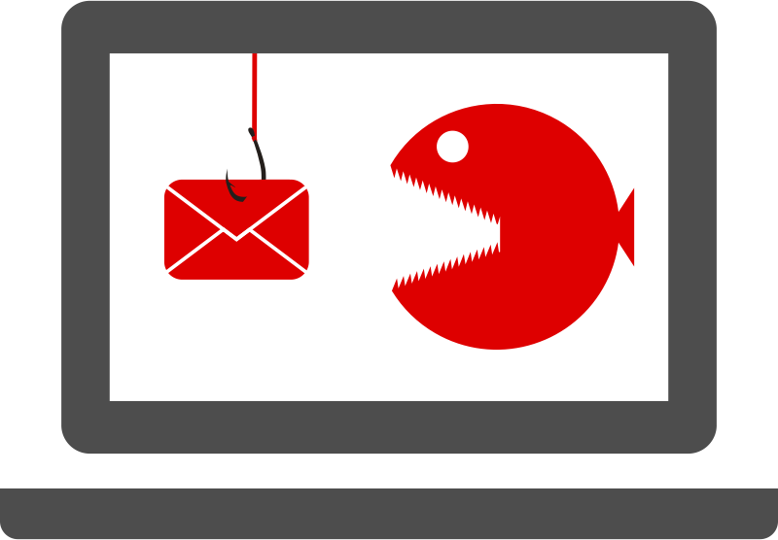
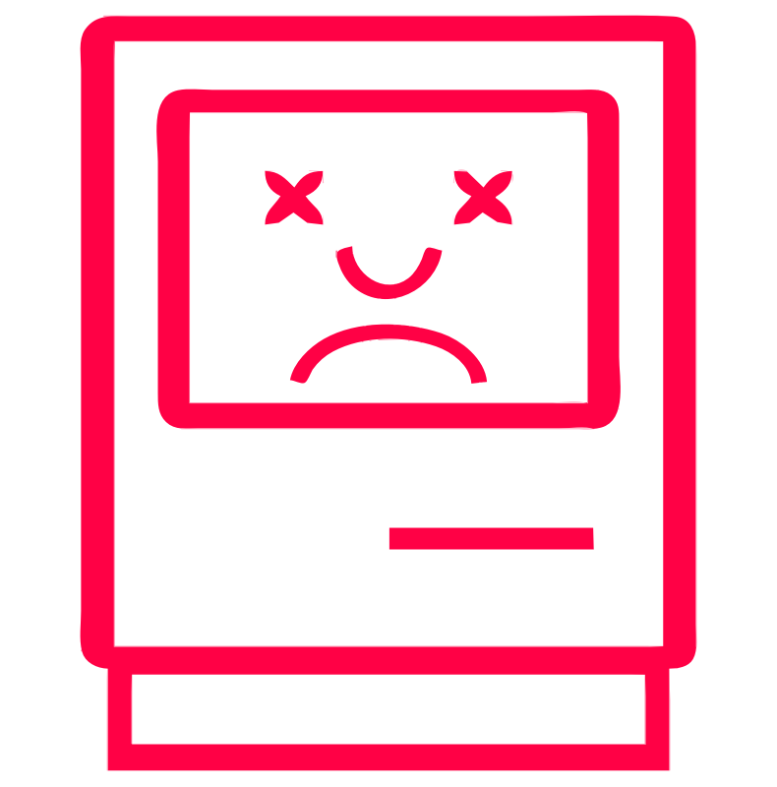
Important Cybersecurity Definitions
Threat: An attacker or piece of malware that desires and/or is able to cause harm to a target
Vulnerability: Flaw in an environment that an attacker can use to harm the target
Exploit: The method by which an attacker can use a vulnerability
Risk: The potential that a threat will exploit a vulnerability
Source: http://www.pen-tests.com/difference-between-threat-vulnerability-and-risk.html

Slide 8
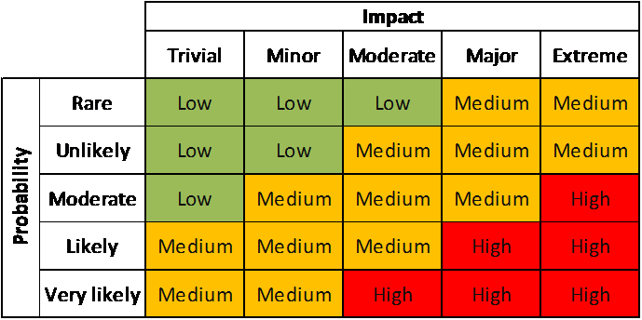
Risks: Probability and Impact
The risk of a cybersecurity attack depends on two factors
Probability
How much motivation does an attacker have to try to exploit my system?
How securely have I protected my system?
Impact
How damaging is a potential attack on my system?
Types of impact: Financial, Health and Safety, Personal, Service Interruption
Risk Matrix
Source: http://2.bp.blogspot.com/-xSHY5tsTvvY/Tzqi_kSorfI/AAAAAAAABDo/cR71Da7qCQY/s1600/ProbabilityAndImpactMatrix.png

Slide 9
Risk Assessment: Target Breach
Case: Attackers breached Target’s network through a heating and air conditioning (HVAC) company and point-of-sale systems to steal 40 million credit card numbers
Likelihood: Likely
Attackers knew that Target has a massive network with many potential holes and that they could gain a wealth of information
Network was not fully secured; HVAC company had open access to it
Impact: Major
Loss of financial information could have major impact on Target’s customers
Breach was a huge embarrassment to Target and could have led to decrease in future sales

Slide 10
UNIT 4 – SECTION 3 Cyber Threats and Countermeasures

Slide 11
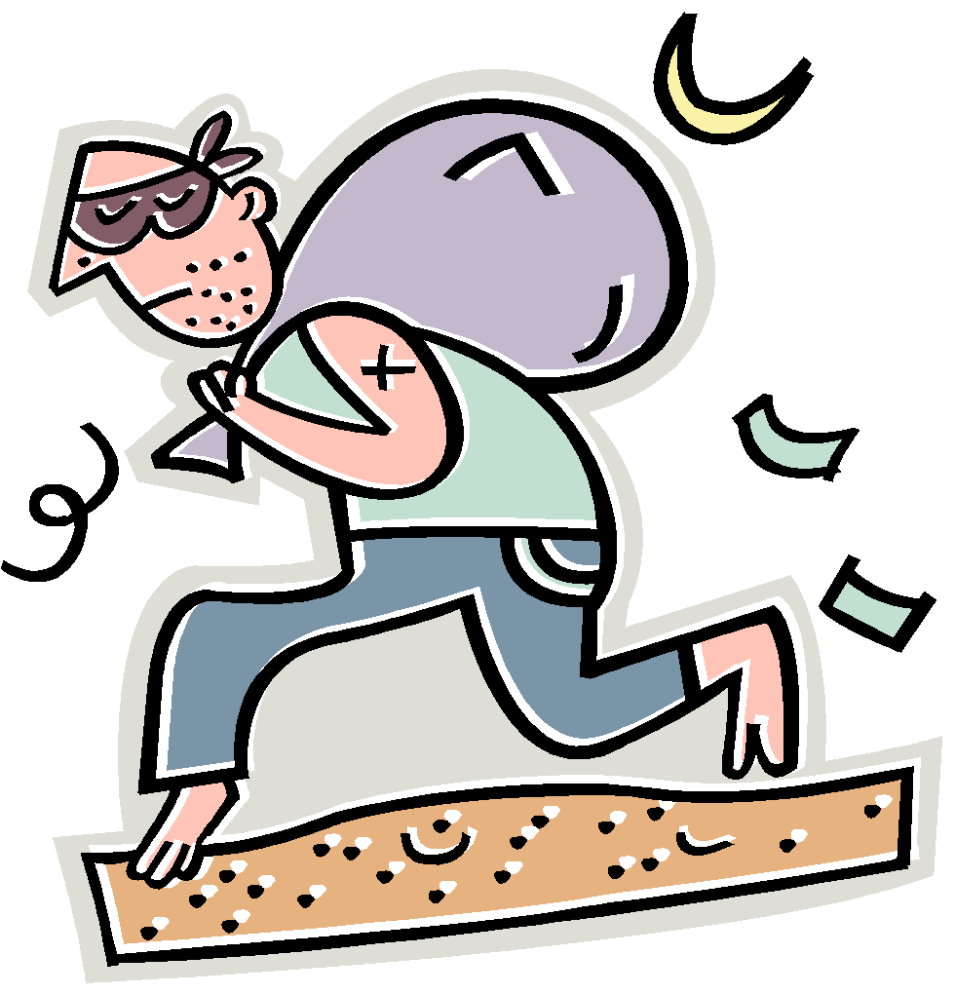
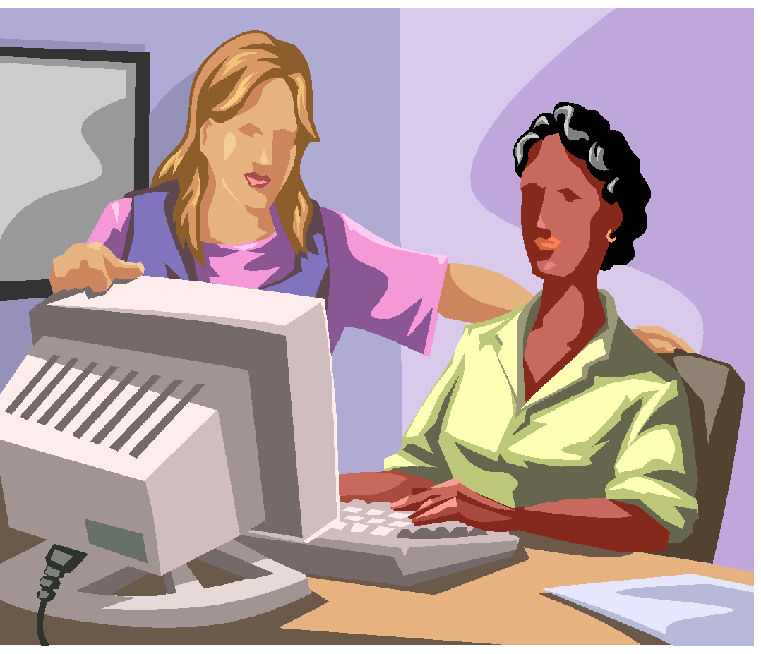
Physical Threats
DUMPSTER DIVING
SHOULDER SURFING
SSN:12 3790888:
Credit Card #s
Acct#: 123281
Emails
Passwords
Dumpster Diving: Thieves sift through garbage for receipts with credit card information, medical forms with social security numbers, or other documents with PII
Shoulder Surfing: By looking over your shoulder as you type, thieves can glean your passwords, account information, and other sensitive information

Slide 12

Cyber Hygiene
Basic personal practices that keep computers and data safe
Lock your computer when in public areas
Shield your keyboard when you type passwords
Do not let strangers use your computer
Keep sensitive information in secure places

Slide 13

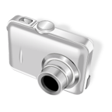
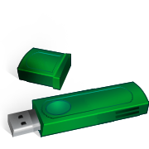
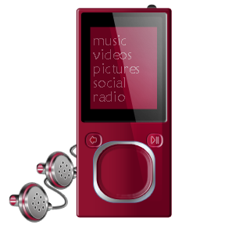
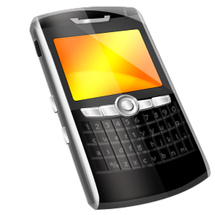
What are mobile devices?
Portable or handheld devices that have data or can connect to another device that has data

Slide 14
Online Threats
SOCIAL ENGINEERING
Thrift Shopping Room
M@ckelm0re: Yo man I got the illest sweaters yesterday
Guests
Ry@nLew1s: Really? What are we talkin? Wool? Pullover? Cardigan?
M@ckelm0re
Ry@nLew1s
Ry@nLew1s: I got a dope cardigan last week. Only 99 cents.
M@ckelm0re: A couple of sick purple pullovers. Dont know if I need 2 tho….whats ur address? I will drop 1 in the mail for u.
|
Send
Social Engineering: Manipulating people into giving up personal information

Slide 15
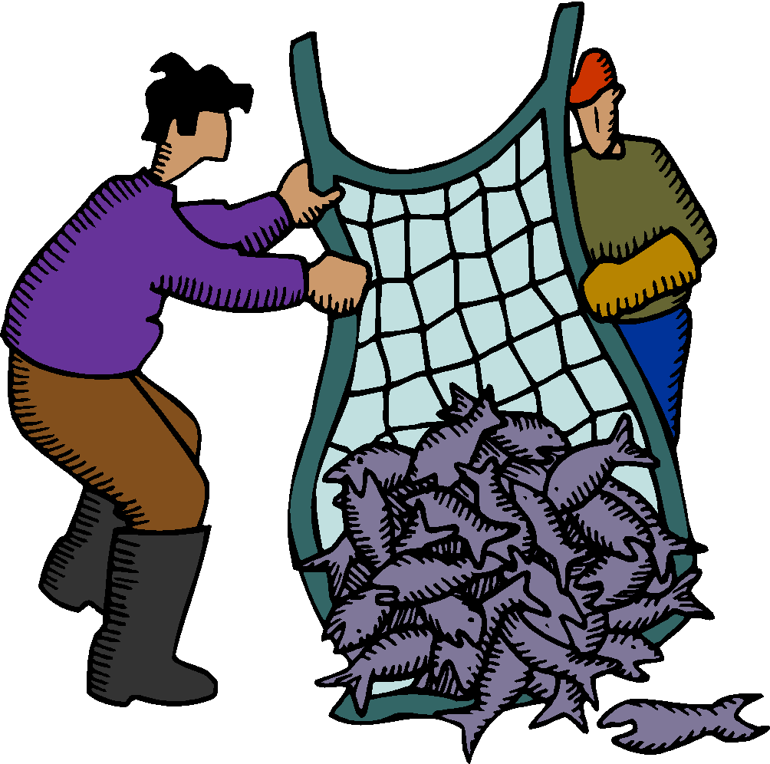
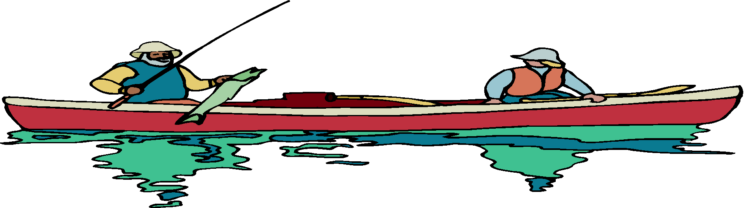


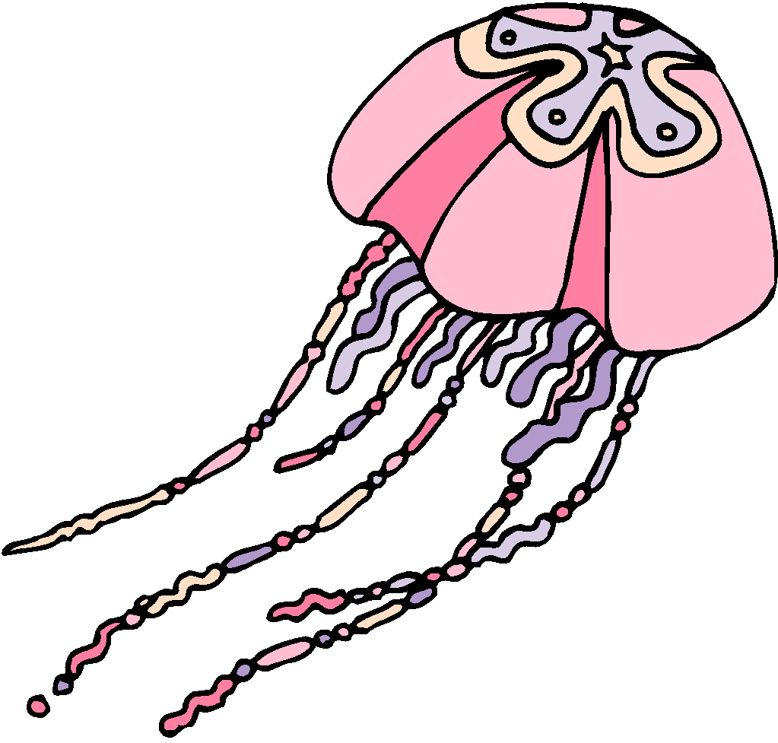



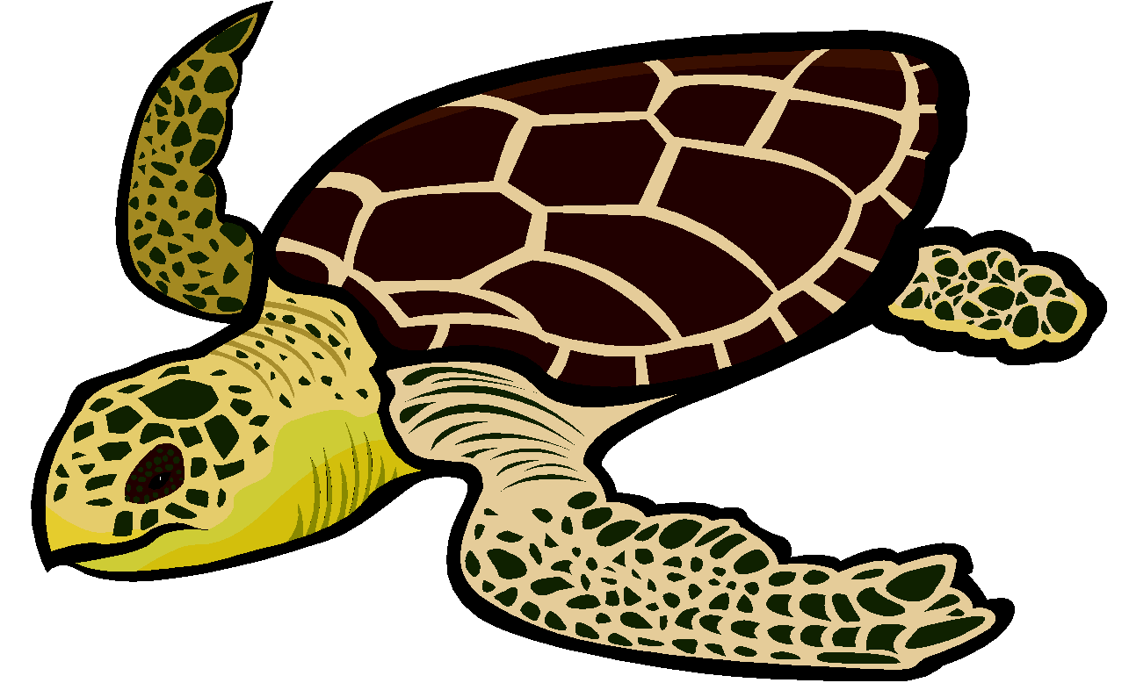
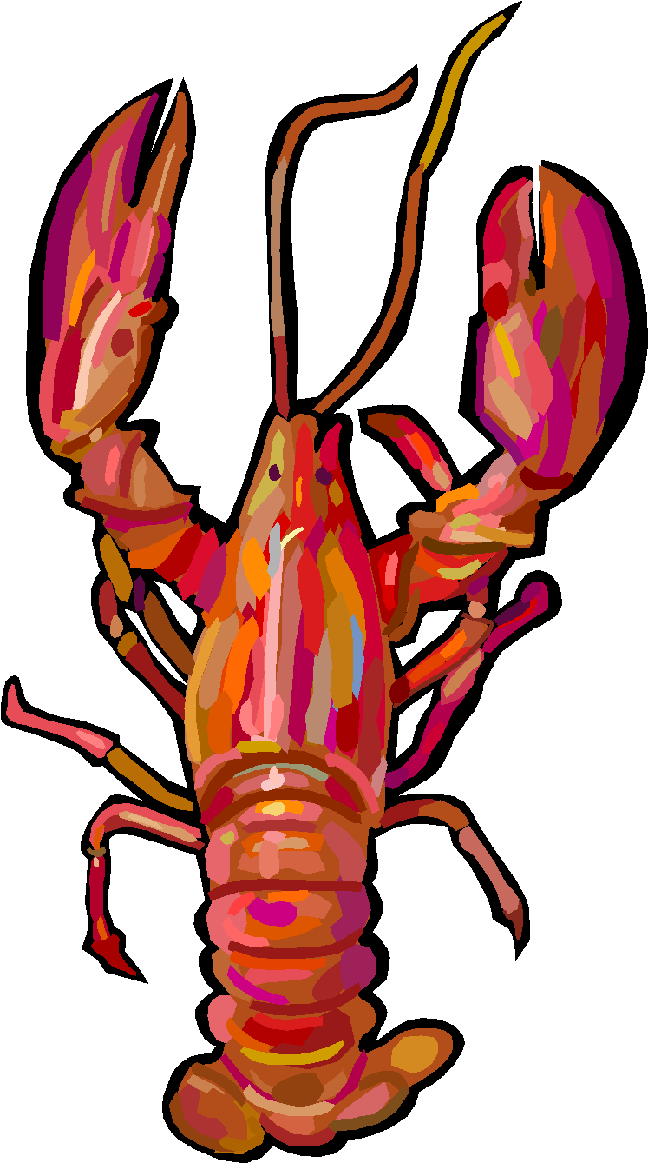


Social Engineering Methods
PHISHING
SPEAR-PHISHING
Phishing: fraud attempts perpetrated by random attackers against a wide number of users
Spear-phishing: fraud attempts targeted at specific people based on their membership or affiliation with a the spoofed group
e.g. fraudulent emails sent to Microsoft employees aiming to steal Microsoft secrets
Vishing: Attempts to manipulate people into giving up PII over the phone
Smishing: Attempts to manipulate people into giving up PII by text message (SMS)

Slide 16
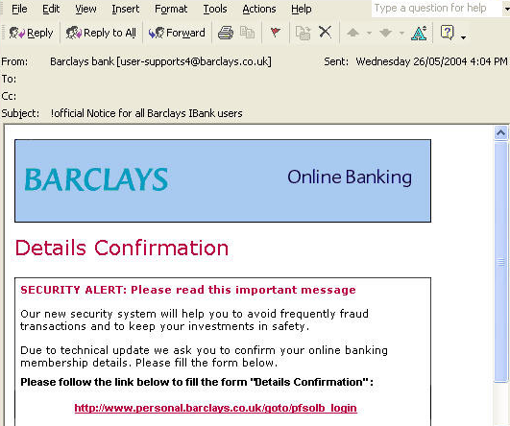
How to Spot Phishing Emails
Phishing attempts are rarely this obvious, but these are useful errors to look for
Spoofed email address
Spelling Errors/Typos
ALL CAPS
Asks for Personally Identifying Information
Executable attachment or link to a Website
Signed by a department, not an individual
Sincerely,
Customer Service
Barclays
Source: www.Vanish.org

Slide 17
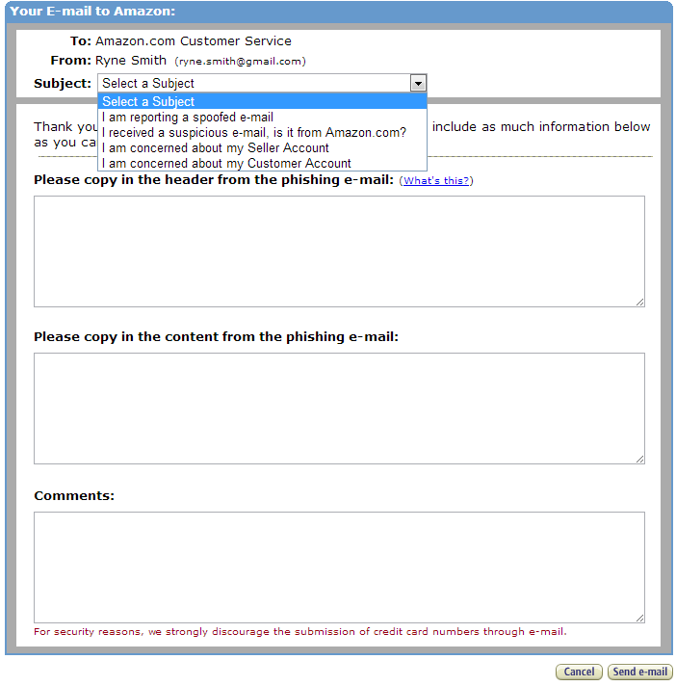
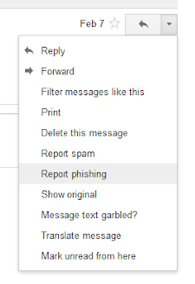
Reporting Email Scams
Report phishing attempts so other people aren’t victimized
Go to the legitimate website of the spoofed organization (not through a link in the email)
Follow the site’s procedure for reporting
Report the spoof to your email provider

Slide 18
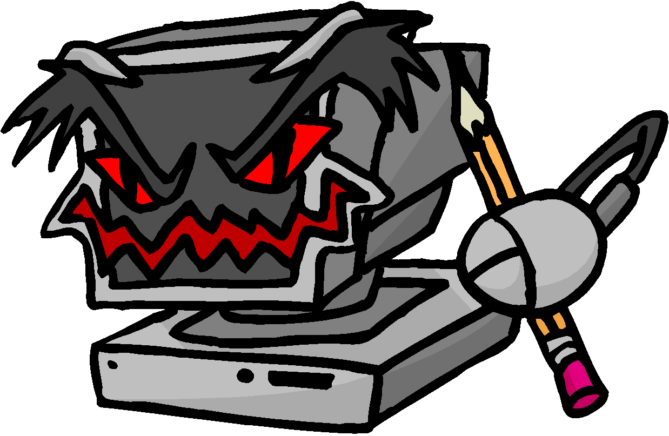
Malware: What is it?
Malicious Software = Malware
Software designed and written to:
Steal information
Spy on users
Gain control of computers
Categorized by
How it spreads
What it does

Slide 19

Malware: What is it?
iruses/Worms
rojan Horses
ombies and Botnets
eyloggers
ackdoors
ogic/Time Bombs
pyware
V
T
Z
K
B
L
S

Slide 20
Malware: Types / Terms
Viruses: Can infect and spread, but need human assistance
Worms: Can infect and spread without human assistance
Trojan horse: Program with a hidden malicious function
Zombies (a.k.a. bots): compromised computers under the control of an attacker
Botnet: a collection of compromised computers (zombies) under the control of an attacker
Keylogger: Tracks users’ keystrokes, obtains passwords and other personal information
Backdoor: An entry point into a program without all the normal, built-in security checks
Logic/time bomb: Malware designed to lie dormant until a specific logical condition is met
Spyware: Collects information about you, without your knowledge or consent

Slide 21
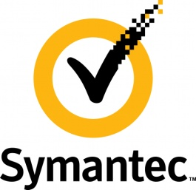

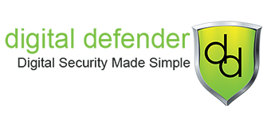


Anti-malware Software
Scans files for matches in databases of known malware
Alerts you when a match is identified or a suspect program attempts to run
Quarantines and removes infected files
Source: www.pcworld.com
Source: www.royalpccare.com
Source: www.digital-defender.com
Source: www.wikipedia.org

Slide 22
UNIT 4 – SECTION 3 Basic Cybersecurity Techniques

Slide 23
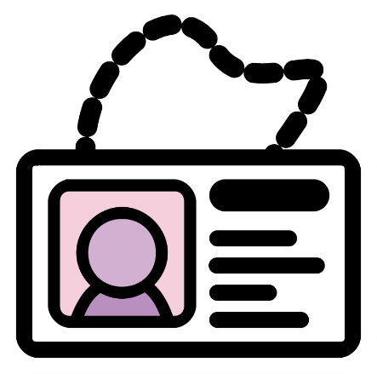
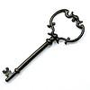
Basic Cybersecurity Techniques
Identification: Providing user identity to a system
Authentication: Verifying the user’s identity
Authorization: Determining whether a user is allowed to access certain resources
Accountability: Holding users responsible for their actions on a system
Source: http://www.infosectoday.com/Articles/Authentication.htm

Slide 24
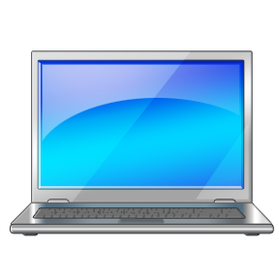
Identification and Authentication
Uses encryption to ensure that a user is
who they say they are
Methods:
Passwords
Physical “keys” (key chains, swipe cards)
Biometrics (fingerprints, retina scanning)
Threats:
Brute force cracking
Test every possible combination of letters, numbers, and characters until the password is found
Dictionary cracking
Test words and combinations of words found in the dictionary or from a slightly shorter list of words known to be commonly used in passwords
Password:
* * * * * * * *

Slide 25
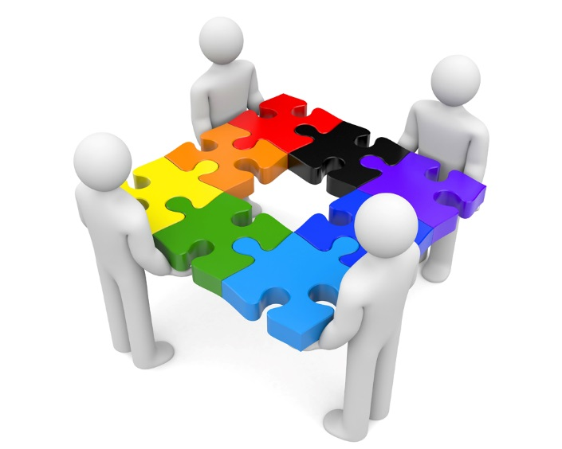
Authorization
Uses tools to control access to a resource
Methods:
File permissions
Account management
Sharing settings
Threats:
Insider Threats
Disgruntled or inexperienced employees that have high-level access may cause intentional or accidental harm to a system
Elevation of privilege
Attacker is able to enter the system as a low-level user, but is able to attain high-level access
Methods covered in detail in Units 7 and 8

Slide 26
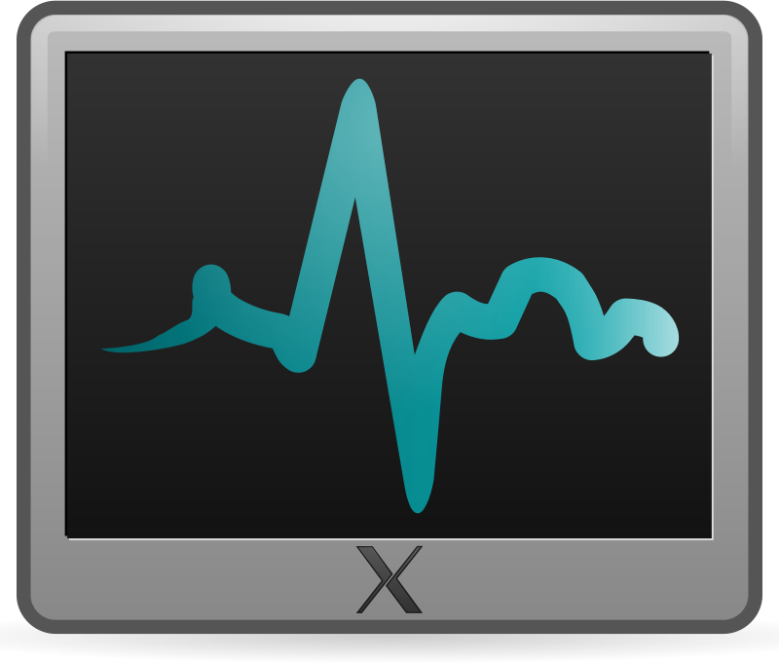
Accountability
Holds users responsible for their actions on a system
Methods:
System monitoring
Audit logS
Threats:
Denial of Service
Attack overwhelms audit logs with excessive or very large log entries, causing the system to run slowly or not at all
Disclosure of confidential information
Attacker is able to gather confidential or personally identifiable information from log fileS
Methods covered in detail in Unit 8
Source: http://www.infosectoday.com/Articles/Authentication.htm

Slide 27


Authentication: Building Strong Passwords
REMEMBER:
NOT:
C
L
O
U
D
S
Source: tamutimes.tamu.edu
S
U
N
Notes:
C: Complex
L: Length
O: Only Yours
U: Unique
D: Different
S: Short Term

Slide 28
Passwords - Complex
Passwords of 8 characters consisting of
Numbers only: 100 million
+ Lower case: 2.8 trillion
+ Upper case: 210 trillion
+ Symbols: 7.2 quadrillion
Cracked under one second
Cracked under eleven minutes
Cracked under fifteen hours
Cracked under three weeks
Always use at least 3 of the following:
Numbers
Lower case letters
Upper case letters
Symbols (% # * & ! : { “ > |)
Ronald’s Old Password: 1234 New Password: Pa123!
Source: www.howsecureismypassword.net

Slide 29
Passwords - Lengthy
Brute force attacks can run 4 billion calculations per second
Six or fewer characters
Seven characters
Eight characters
Nine characters
Ten characters
Cracked within three minutes
Cracked within five hours
Cracked within three weeks
Cracked within five years
Cracked within 526 years
Always use at least 8 characters
Ronald’s Old Password: Pa123!
New Password: Password123!

Slide 30
Passwords - Only Yours
Do not share your password with ANYONE

Slide 31
Passwords - Unique
Any of the top 10,000 passwords will be broken immediately
91% of people have one of the 1,000 most popular passwords
Almost half of all people use one of the 100 most popular
password
123456
12345678
abc123
qwerty
monkey
letmein
dragon
111111
baseball
iloveyou
trustno1
1234567
sunshine
master
123123
welcome
shadow
Ronald’s Old Password: Password123!
New Password: Ronald123!

Slide 32
Passwords - Different
Use different passwords for each login (e.g. Gmail and Facebook)
Example: [base password] [site]
Gmail: [Ronald123!] [GMA] = Ronald123!GMA
Facebook: [Ronald123!] [FAC] = Ronald123!FAC
Ronald’s Old Password: Ronald123!
New Passwords: Ronald123!FAC and Ronald123!GMA

Slide 33
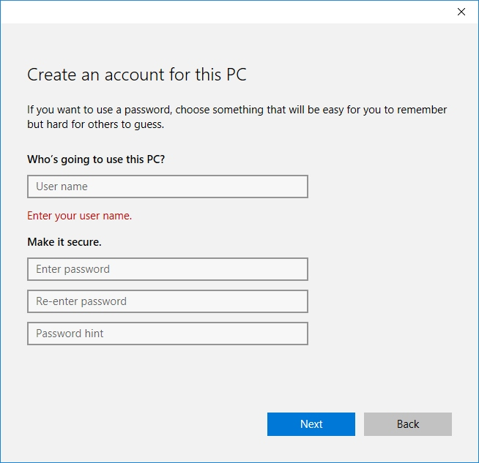
Passwords - Short Term
The longer you keep a password the longer attackers have to try and crack it
Changing your passwords regularly can help foil cracking attempts as they happen
It’s best to change your passwords at least every few months

Slide 34
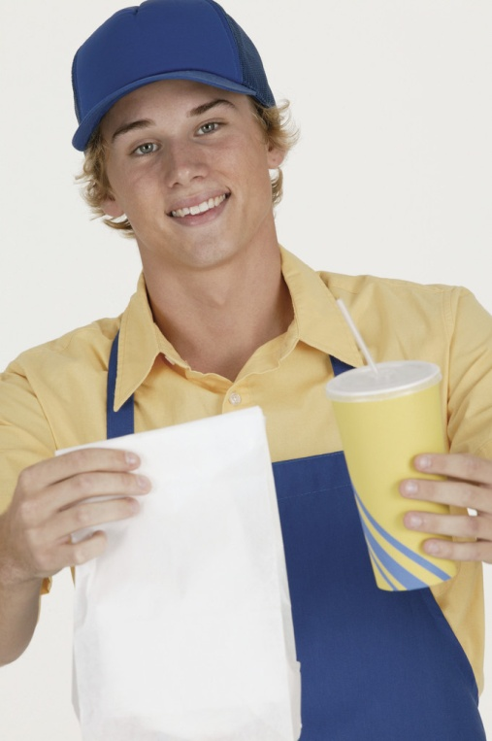
Passwords NOT Simple
Do not use dictionary words
Fend off dictionary cracking attacks by using passphrases
Where’s the beef?
Wh
D@
B33f?
WhD@B33f?

Slide 35



Passwords - NOT User ID
User ID is publicly available
Using it as a password = Giving it away

Slide 36

Passwords - NOT Name
Do not use any personal info – can be easily found by other means
Name
Birthday
Pet’s Name
Mother’s Maiden Name
Hometown
Old Gmail Password: Ronald123!GMA
New Password: WhD@B33f?GMA
Old Facebook Password: Ronald1234FAC
New Password: WhD@B33f?FAC

Slide 37
Building Strong Passwords
REMEMBER:
NOT:
Complex
Lengthy
Only Yours
Unique
Different
Short Term
Source: tamutimes.tamu.edu
Simple
User ID
Name

